Slide 1





New Year
Happy
2027
This wallpaper is blessed with a New Year’s spell
Wishing you good energy, health, and joy with your loved ones, plus smooth sailing in your job

Slide 2

New Year
Happy
2027
This wallpaper is blessed with a New Year’s spell
Wishing you good energy, health, and joy with your loved ones, plus smooth sailing in your job

Slide 3

Happy
New Year
2027
Warmest New Year wishes for you:
Good energy, strong health, family joy, and smooth success at work.

Slide 4

Happy
New Year
2027
Warmest New Year wishes for you:
Good energy, strong health, family joy, and smooth success at work.

Slide 5









All High GMV
2,413,0000,000
Big congratulations to the Kamero team on our new milestone!

Slide 6






All High GMV
2,413,0000,000
Big congratulations to the Kamero team on our new milestone!

Slide 7













All High GMV
preVAT

Slide 8







All High GMV for the Milestone at 200M+
227,673,474 VND
pre-VAT

Slide 9


All High GMV
1,282,000,000 VND
preVAT

Slide 10





Launching Automated
Daily Reports
The BOS team is pleased to announce the launch of our Automated Daily Report workflow. Our goal is to provide uninterrupted data flow 24/7, including weekends and public holidays. .
The BOS team is pleased to announce the launch of our Automated Daily Report workflow. .

Slide 11









LAUNCHING AUTOMATED
DAILY REPORTS
365 days of data! We’re thrilled to launch the "always-on" Automated Daily Report. This upgrade gives Sales and Ops teams real-time visibility into daily revenue and order volume, even on weekends and holidays.
⚠️ Note:
Reports on working days are reviewed before delivery.
Since these are auto-generated, the BOS team will perform a final data polish on the next business day to ensure everything is 100% accurate.

Slide 12







Kamereo.
Introducing the AI-Powered Research
NotebookLM
Meet NotebookLM, the AI research tool and thinking partner that can analyze your sources, turn complexity into clarity and transform your content.

Slide 13
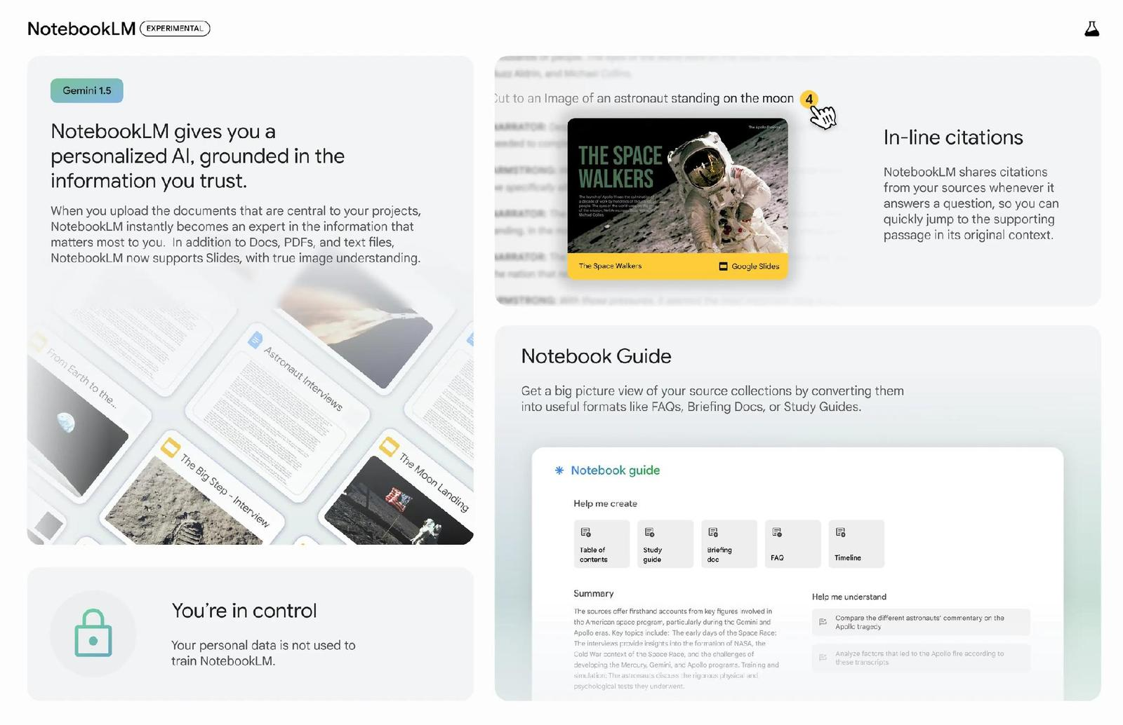

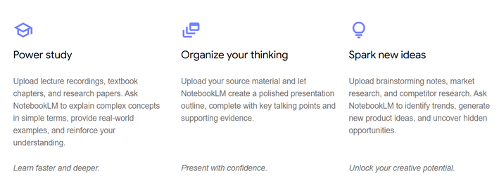
Kamereo.
Current Pain Points
Core Functionalities
Quick Start Guide
Sales
e-Mentor
Getting Started with NotebookLM

Slide 14















AI Candidate Screening & Scoring Workflow
Kamereo.
HR’s Decision
HR
Hiring Platforms
Upload CVs & JDs
Send Notification
via Slack
Retrieve CVs & JDs
AI Scoring to Google Sheets
Extract
Candidate’s Info
Manual review might overlook qualified talent
Spend hours to collect, store candidate’s info
AI Analyze CVs against JDs

Slide 15

CURRENT CHALLENGES
INTERNAL
EXTERNAL

Slide 16




INTERNAL
1
2
3
Lack of Team Leaders and staff
Long training time for new hires
New hires are still ramping up to handle the full workload

Slide 17






EXTERNAL
1
2
3
Natural Disasters
High Customer Expectations
Product & Service Quality
4
5
6
Supply Chain Disruption
VAT Regulation Changes
Price Fluctuations

Slide 18


BOS - Next Steps
Strategy Advisory
Performance Review
Data Management
Support for bonus scheme in 2026 (HCM + HN)
Review KA team activities to identify opportunities for automation, reduce repetitive tasks, and improve efficiency.
Collaborate with Tech: Enhancement to Improve PO Handling for Customers Requiring PO when delivery
Support for bonus scheme in 2026 (HCM + HN)
Review KA team activities to identify opportunities for automation, reduce repetitive tasks, and improve efficiency.
Collaborate with Tech: Enhancement to Improve PO Handling for Customers Requiring PO when delivery
Support for bonus scheme in 2026 (HCM + HN)
Review KA team activities to identify opportunities for automation, reduce repetitive tasks, and improve efficiency.
Collaborate with Tech: Enhancement to Improve PO Handling for Customers Requiring PO when delivery

Slide 19


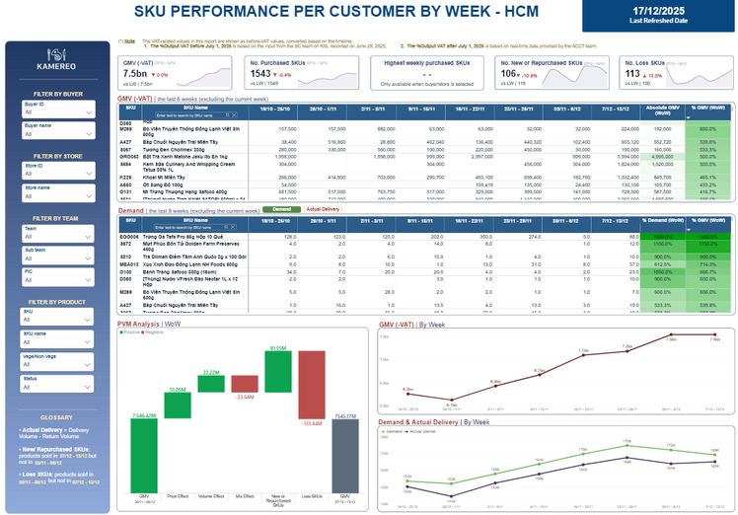


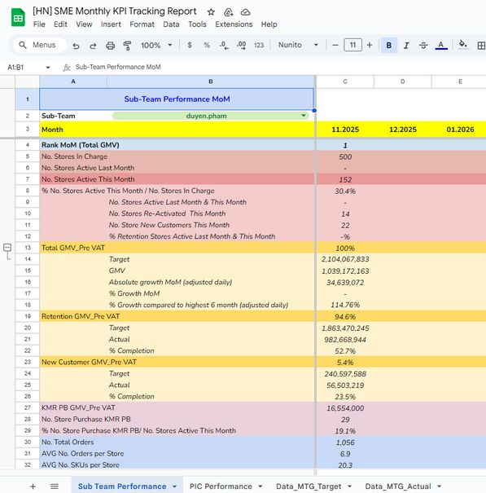
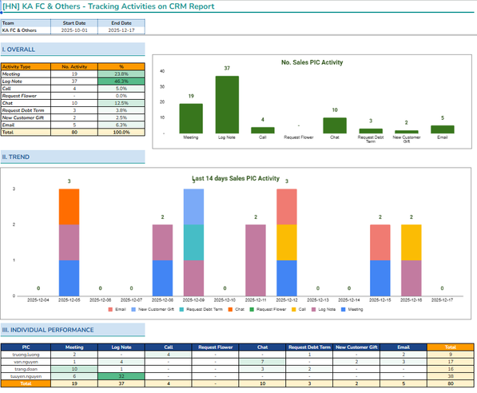

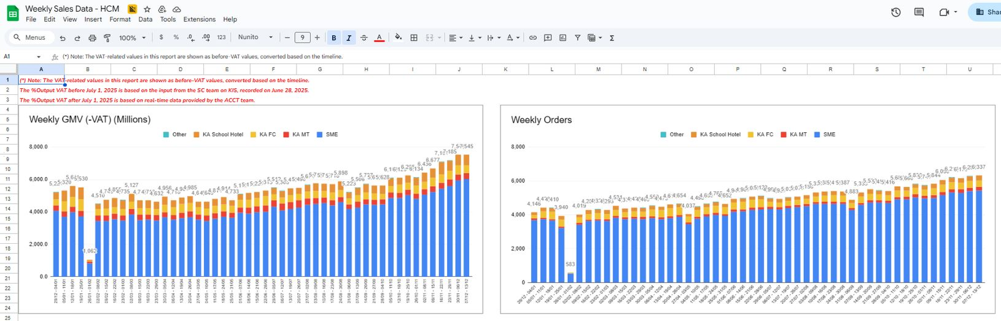
BOS - Kaizen & Activities
1
22.11.2025
SKU Performance Per Customer Dashboard
[HCM], [HN]
2
27.11.2025
HN - SME Monthly KPI Tracking
[Link]
Tracking Activities on CRM Report
KA FC School Hotel Team
[Link]
3
27.11.2025
4
05.12.2025
Update Weekly report HCM
(Range time 29/12/2024 - Now)
[Link]
1. Reports/Projects

Slide 20
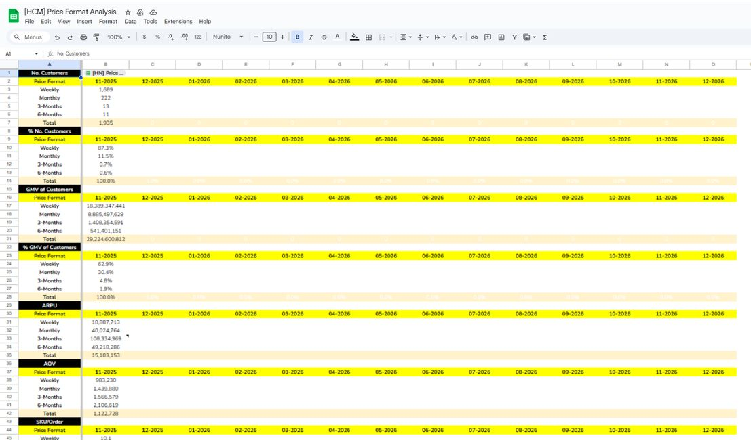
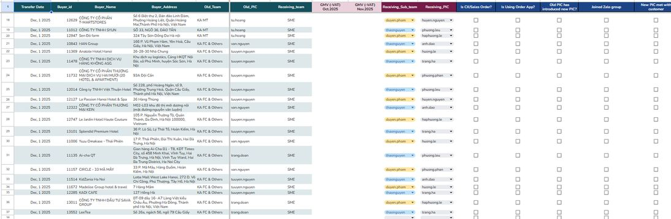
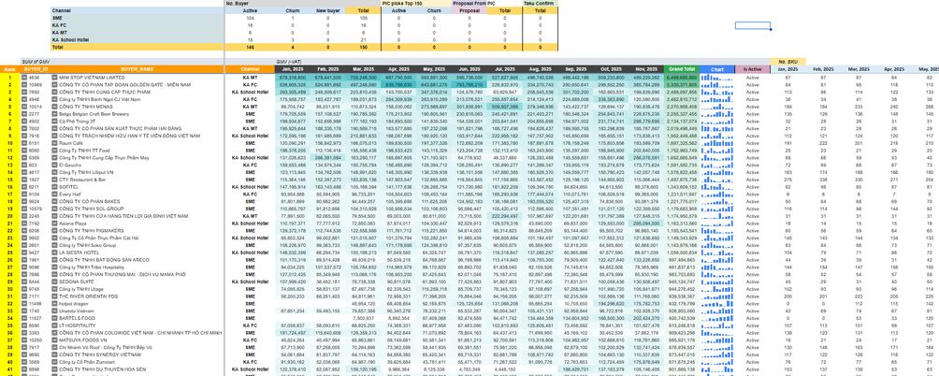
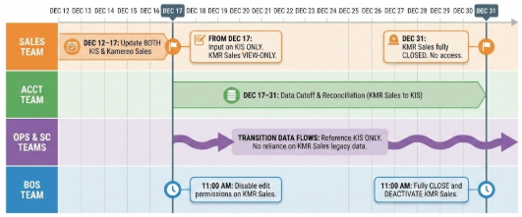
BOS - Kaizen & Activities
5
12.12.2025
Price Format Analyst [HCM/HN]
[HCM], [HN]
6
09.12.2025
HN & HCM KA Customer Transfer Plan
KA to SME Teams (Dec 2025)
Next Step & Actions [Link]
7
11.12.2025
Prepare data for the Top 150 GMV customers
for the New Year Gift Program.
[HCM], [HN]
8
12.12.2025
12.12.2025 - BOS | Transition Plan | Discontinuation of
KMR Sales File (HCM + HN)
[Link]
2. Ad-hoc

Slide 21
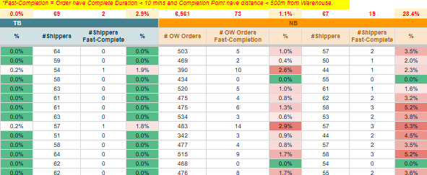
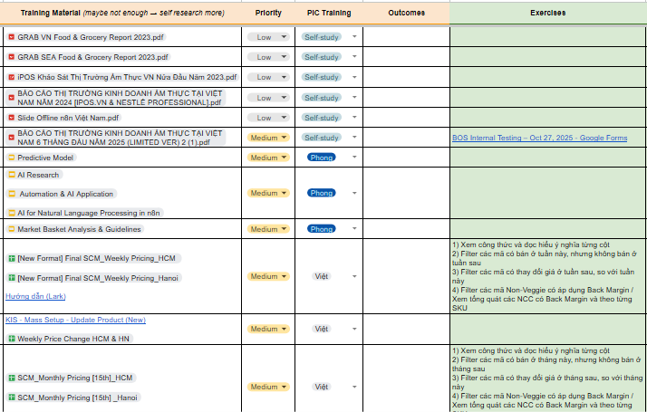
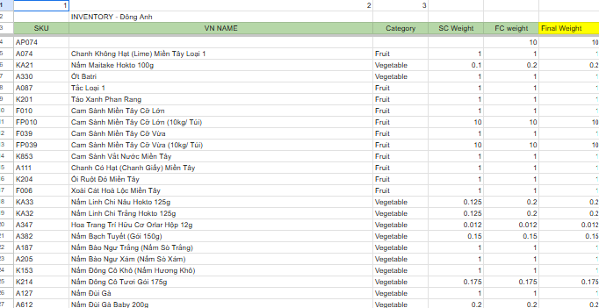
BOS - Kaizen & Activities
9
21.11.2025
Check Fast-Complete Shipper HCM
[Link]
10
24.11.2025
Prepare career learning for BOS newbie
[Link]
11
26.11.2025
Double Check HN FC Weight and remind FC to fix the weight
[Link]
12
03.12.2025
Update credentials, schedules when BOS members left
3. Operation/BOS Hiring

Slide 22


UPDATE Q4'2025
BOS TEAM
Date: January, 2026

Slide 23



Customer Sample Giveaway During Warehouse Visit
Submits Sample Request on Official Channel
Hands Over Sample to Customer
Creates Sample Order on Supplier
Conducts CRM
Follow-up
02
04
Sales PIC
05
06
Sales PIC
Sales PIC
01
Receives Customer Sample Request
Ops Team assign staff to prepare the items
Sales PIC
Creates the delivery note
and sends it to Sales PIC
03
Ops Team
Sales PIC

Slide 24


Customer Sample Giveaway During Warehouse Visit
List First, Pick Late
*Note:
Sales Team in Charge
Ops Team in Charge
During Warehouse Visit
Follow-up in
15–30 days
01
02
04
Receive Sample Request
Submit Official Request
Hand Over Samples
03
Ops Team in Charge
Sample Preparation
Prepare Delivery Note
05
Same-Day Warehouse Visit
Creates Sample Order
06
Next 15-30 Days
Follow Up on CRM

Slide 25









Ha Noi
Da Nang
Ho Chi Minh

Slide 26
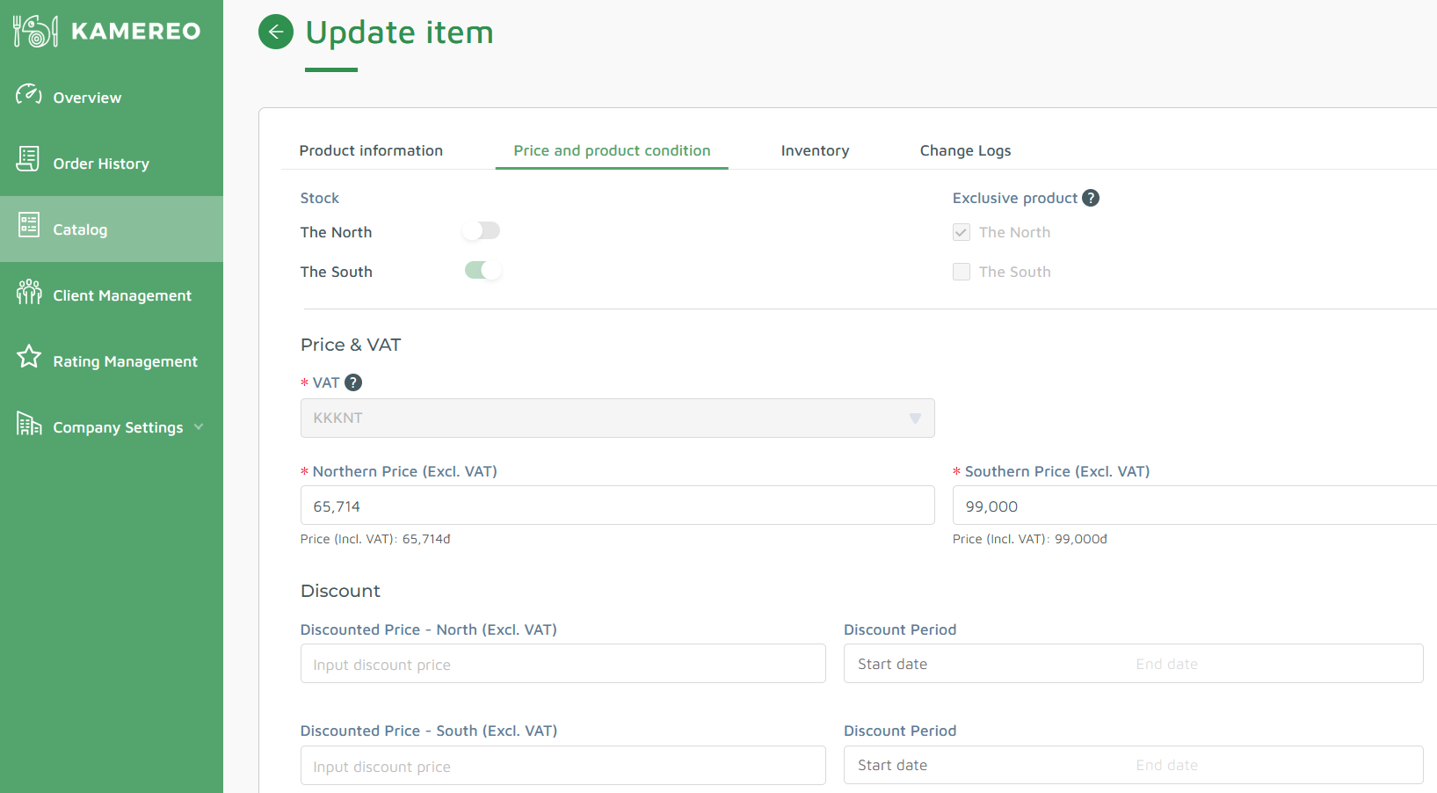




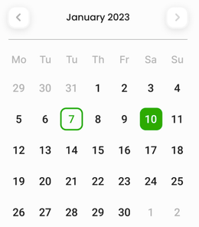

2
1
Yellow Passion Fruit Da Lat
K826
The North
Mark as Out of Stock
The South
Mark as In Stock
Out-of-Stock Reporting Form
Select Reason
Expected Restock Date
Supply Shortage
2026-04-12
Quality Issue
Seasonal End
Price Fluctuating
Detailed Reason
Provide more context (e.g., supplier name, batch number)...

